Slide 1
In the Beginning
By Kate Ordon
From the series ‘Start with the Heart’

Slide 3
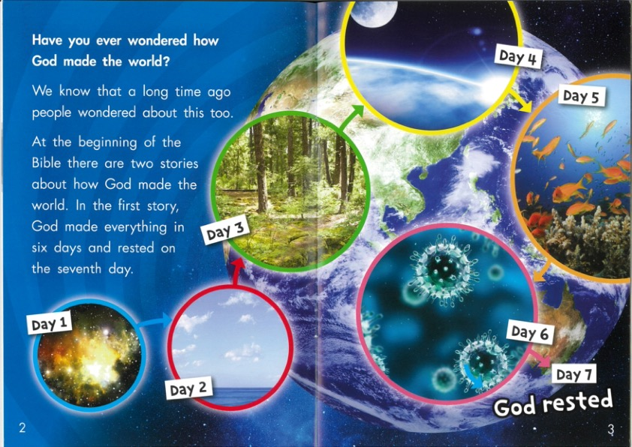

Slide 4
